Slide 1
Graph Classification Task: More Node Features and Spatiality
Yikang Li 2022/7/31

Slide 2

Overview
Binary graph classification Tasks
ADNI dataset - Patients/Controls classes. Node: 90, Amount: 218
AD dataset - AD/CN classes. Node: 90. Amout: 202
Tested the performance of different node features on different datasets
Tested the performance of adding the spatiality to current GNNs.

Slide 3
Model Evaluation on ADNI Dataset
1. 4D Node feature input does not perform better compare to other node features.
2. GNN is highly affected by the noise, sometimes the results become extremly good.

Slide 4
Model Evaluation on AD Dataset

Slide 5
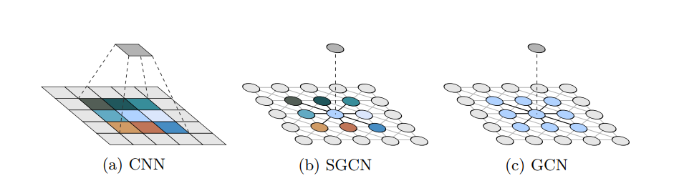
Spatial Graph Convolutional Network:
01 | Comparing to the classical GCN, spatial GCN can effectively extract the geometric/spatial features of graphs by utilizing the node positions.
02 | Spatial GCN is a proper generalization of GCN and CNN, which conbines the advances of GCN and CNN.
03 | It effectively increases the precision on graph classification tasks for super pixel MNIST dataset.
04 | Data Augmentation methods such as node ordering, rotation and translations can be utilized since the spatial GCN can extract the selective invariance of spatial properties.

Slide 6
Results of Spatial GCN on different datasets
1. Spatial GCN does not performs better on two different datasets compared to existed GNN.
2. Adding spatiality to current GNNs does increase the performance of the classification tasks.

Slide 7
Thank you.

